Slide 1

CS 100: Software Construction
Original slides by: Brian Crites
Updated by: Jeffrey McDaniel, Reem Ali and Neftali Watkinson

Slide 2


Welcome to Upper Division

Slide 3
Agenda
Introductions
Purpose and Goals of this course
Syllabus
Slack
Labs and Homework
Project
Collaboration policy

Slide 4
Introductions
If you are watching from Zoom, change your display name to handle – NETID
If I don’t, please remind me to record the lecture!
Start answering the background survey at https://pollev.com/reemali518
Breakout Activity: What skills do I need to be a better coder?

Slide 5
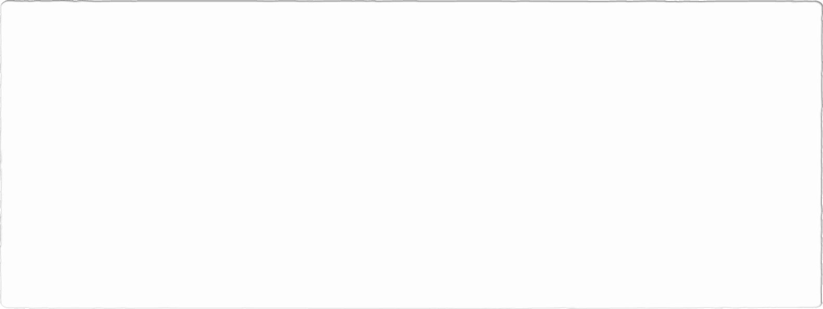
What do I need?
Clean and informative coding
Proper organization
Keep track of changes
Communicate with others
Be professional and ethical
WORK WELL WITH OTHERS!!!!

Slide 6
Purpose of this Course
CS 100 +
CS 180
A software architect is a software expert who makes high-level design choices and dictates technical standards, including software coding standards, tools, and platforms.
+
All Other Classes
A full stack developer is an engineer who can handle all the work of databases, servers, systems engineering, and clients.

Slide 7
Goals
Development Methodologies
Testing Strategies/Methods
System Design
Common Tools
Common Terminology
“Large” Scale Development Practice
Working with a Group
Ethics
After this course you should be ready for an internship
and you should apply for one!

Slide 8









Notes:
We send undergraduates to lots of highly prestigious internships and full time positions.

Slide 9
Student Organizations
Association of Computing Machinery (ACM) @ UCR
Women in Computing (WinC) @ UCR
Institute of Electrical and Electronics Engineering @ UCR
Cyber(security) @ UCR

Slide 10

Course Text
Design Patterns by Erich Gamma, Richard Helm, Ralph Johnson, and John Vissides
Not required, but is the origin for most of the slides and makes a great desk reference
It has also been highly recommended by students from previous quarters

Slide 11

GitHub
You will need a GitHub account for this course. It is best to set it up right away.
It does not need to be associated with your UCR NetID.

Slide 12

Review Material
Basic Linux Navigation
Basics of g++ Compilation
Inheritance & Polymorphism*
Introduction to the Standard Template Library*
*Review slides on these topics will be posted on Canvas

Slide 13
Syllabus
Refer to Canvas for the most updated syllabus and links
Course Tools:
Slack: Use for all class communication and announcements
Canvas: lecture slides, recordings, ethics assignments, links to labs , gradebook.
GitHub: labs and project submissions.
Grading breakdown
Schedule
Policies:
No late submission

Slide 14
Slack
Make sure you register with your OFFICIAL UCR email
Change display name to: "handle - NETID" e.g., “Reem - reema“
FULL NAME and UCR EMAIL should match OFFICIAL Canvas records
Add a profile picture
Please post all questions and answers on the #general channel.
Direct message the instructor only if it is about (1) medical or (2) grades.
Channels: #general: main forum for interaction #announcements for announcements from instructors/Tas #labs: lab related questions #ethics: ethics assignment related questions #group-formation: introduce yourself, find partners for labs and project #exams: exam related info #random: for all crazy things and fun

Slide 15
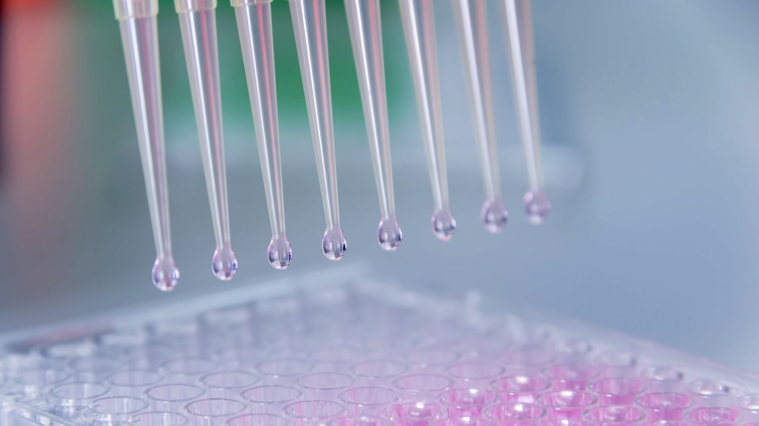
Labs
The first lab is an individual lab.
The remaining labs will be done in pairs.
Labs are assigned and submitted through GitHub
If you already have an account, you can use that one
If you don’t already have an account, please create one immediately
Must be able to build and run on hammer
Notes:
Submissions which contain threats or otherwise reportable information will be reported to the university and/or campus police

Slide 16

Ethics assignments
There will be 4 assignments
For each assignment you will participate in a discussion within a small group
You will have ~1 week to read the material in the assignment and participate in the discussion
You are being graded for engaging with the material, not your opinions*

Slide 17
Ethics assignments (RUBRIC)
In order to get full credit, you need to participate in the discussion at least twice. Each participation should satisfy at least 3 of the following:
The participation is engaging and inviting to continue a conversation
The participation shows the student's effort in reading and understanding the material
The participation references external information in a clear and concise manner
The participation continues a line of thought from other participations
The participation is posted at least 24 hours before the deadline to allow for replies
Extra participations just need to stay on topic. The more you participate the more personal growth you will get out of these assignments!!

Slide 18
Project
This is where you get to show off, have fun, and add to your resume
Start looking for a group now. Group of 4 (2 lab teams)
Start the assignments when they are assigned
Focus on the process not just the final deliverable
Number 1 item in student feedback is wishing to have started the project earlier

Slide 19
Working in Groups
Use the #group-formation slack channel to introduce yourself and form groups
If your group is not formed (for lab and for project) by Thursday of week 1, please message your TA with your name and lab number. They will match you.
Doesn’t have to be your best friend

Slide 20
Four Stages of Team Formation (+ Mourning)
Forming
Storming
Norming
Performing
Adjourning / Mourning

Slide 21
Collaboration, Cheating & Self Plagiarism
You can discuss ideas with peers and get feedback.
Referencing or copying some or all of someone else's code is cheating
If this is not your first time taking this course, you must email the instructor for approval to reuse code from a previous quarter
ASK FOR HELP.
DO NOT CHEAT!

Slide 22

Questions?

